Slide 1


Cheapest Flight Tracking Project
By: Tair Schapira and May Ogen

Slide 2

Introduction

Slide 3

Introduction
Who wouldn’t want to go on vacation while still trying to save money?
Can cheap flights be predicted and if so, what different attributes can affect the cost?
Understanding the factors influencing flight prices is crucial for budget conscious travelers and travel industry professionals

Slide 4
Project Objective
Investigate whether it is possible to predict cheap flights
Identify the various attributes that can impact the cost of the flight
We aim to leverage machine learning techniques to build accurate prediction models that can forecast flight prices based on a variety of factors

Slide 5
Data Collection and Web Crawling Process
www.expedia.com
Choosing at random different flight options, such as:
The destination
The trip duration
The flight duration
And more
Extracting the information of the cheapest flight that fit the criteria chosen

Slide 6
Crawling

Slide 7
Data Collection
Employed web crawling techniques using Selenium to gather flight data
Automated a system that simulates a person choosing their desired departure flight
Focuses on flights departing from Tel-Aviv Ben Gurion Airport and arriving in various popular destinations in Europe
Programmatically navigated through web pages, while interacting with elements and retrieving relevant flight details
The different features were chosen before choosing the cheapest flight

Slide 8
Attributes Collected
Destination
Flight Duration
Departure Day of the Week
Departure Month
Season
Does the flight overlap a Jewish Holiday?
Any travel option preferences?
Departure Time of Day
Number of connections
Specific Airline

Slide 9
Challenges in Crawling
Security pop up need disabling as it was blocking elements on the site
Interacting with elements in a website that has more than one version causing the html to change
Finding each elements attributes that have the least likeliness of altering while the program extracts data
In case a flight search has no results or there was an error while running, the program restarts the search using a different set of attributes

Slide 10


Two Different Web Versions and Security Pop-Up

Slide 11

Data Cleaning and Processing

Slide 12
Data Cleaning
Data was extracted into an excel document – after every row extracted, the excel document is saved
Extraction was done in a way to minimize data cleaning – no missing data
The code double checks for missing data ‘NaN’
Checks for duplicated rows in the data frame

Slide 13
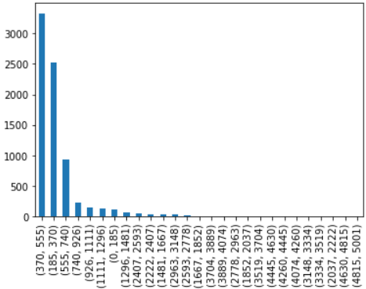
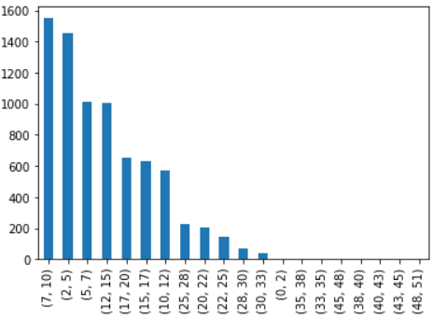

Outliers
Outliers were found in two attributes – the cheapest price and flight duration
Cheapest Prices
Flight Durations

Slide 14

EDA/Visualization

Slide 15
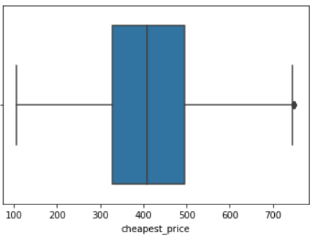
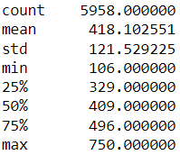
The Cheapest Prices
This graph shows information about all of the flight prices after removing the outliers. We can see properties like the amount of different prices, the maximum price, etc.

Slide 16
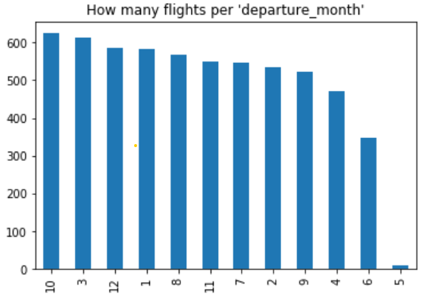
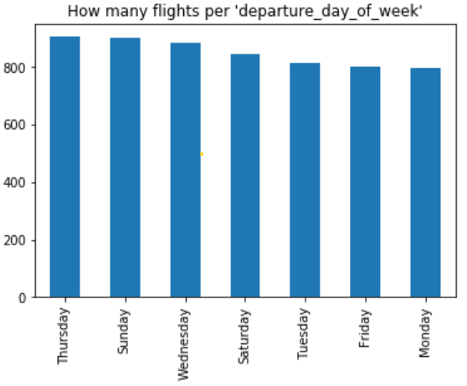
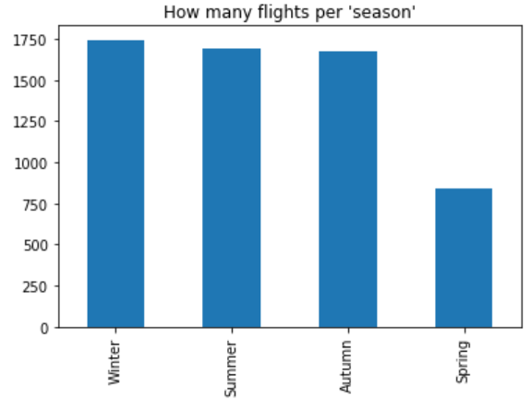
Visualizing the Amount of Flights Per Attribute

Slide 17
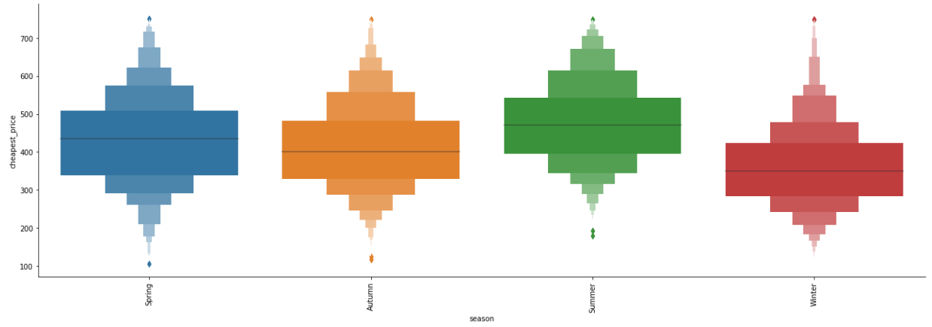
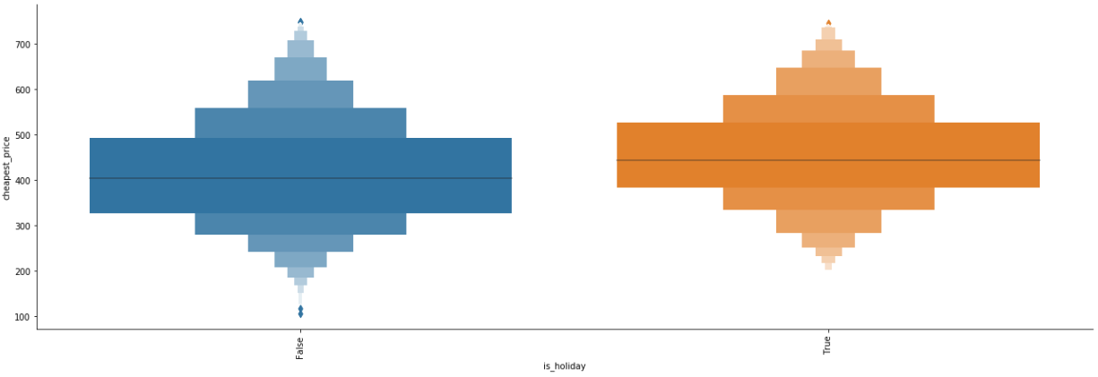
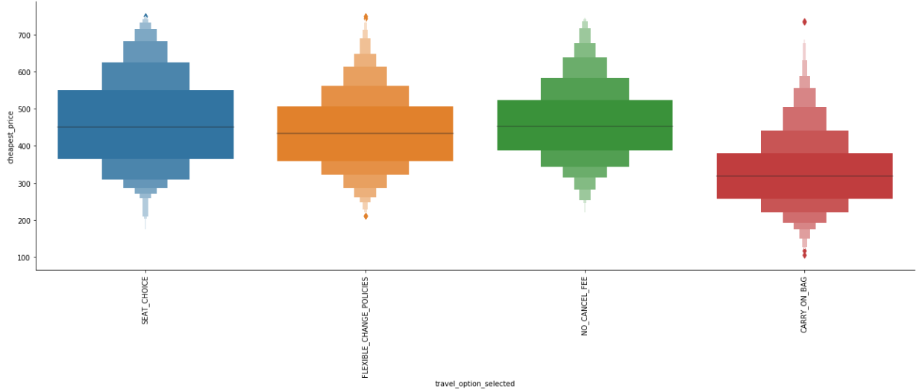
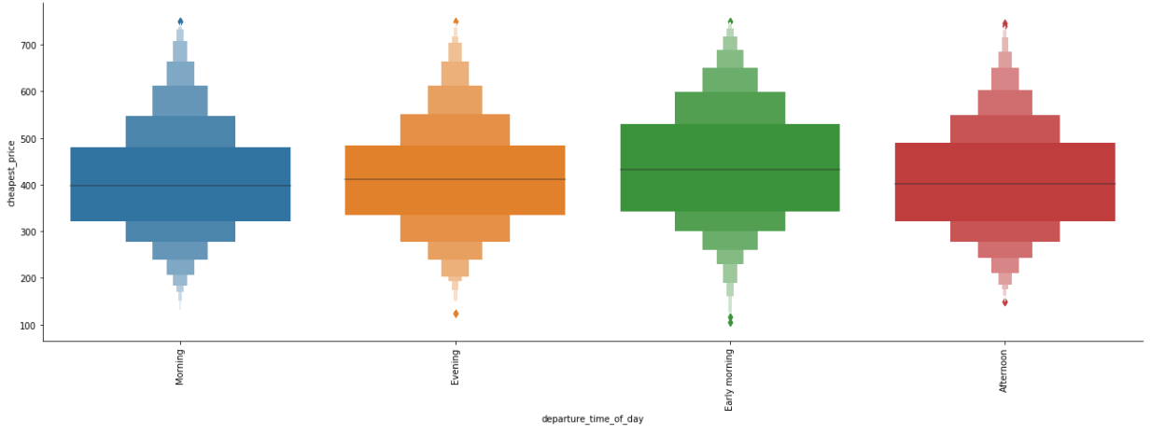
Comparing Each Attribute to the Flight Price
We found some attributes seem to affect the flight price while others do not according to the following graphs
Winter seems to be the cheapest season (as seen in red)
There is a slight elevation in ticket prices during a holiday (yellow)
The price is lower when the carry on bag included (red
The time of day doesn’t seem to have an influence on the price

Slide 18
Machine Learning

Slide 19
Background Info
Each model was built on three different versions of the data frame to compare their accuracies:
Df1 – Solving the regression problem, flight prices and durations are numeric values
Df2 – Solving the classification problem, flight prices are categorized into 5 categories
Df3 – Solving the classification problem, both Flight durations and prices are categorized into 5 categories each
Each model will calculate the following:
MSE
The model’s accuracy
The random forest gives insight to feature importance

Slide 20
The Different Models
Models Used:
Random Forest
Multinomial Naïve Bayes
Logistic Regression
Neural Network
KNN

Slide 21
Model Implementation and Performance Evaluation

Slide 22
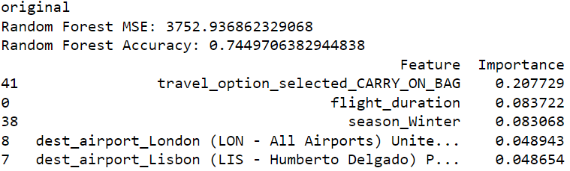
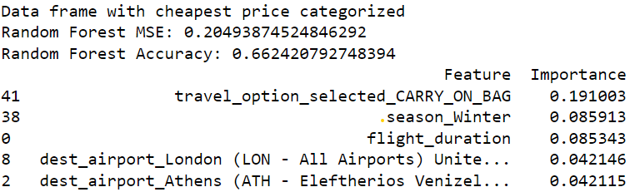
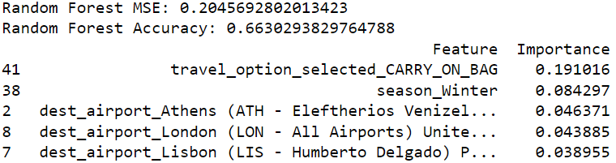
Random Forest
Df1 – Has the Highest Accuracy
Df2 – Cheapest Price Categorized
Df3 – Price and Duration Catergorized

Slide 23
Multinomial Naïve Bayes
Df1 – Has the Highest Accuracy
Df2 – Cheapest Price Categorized
Df3 – Price and Duration Categorized

Slide 24
Logistic Regression
The Logistic Regression Model did not work well with the first data frame (Df1).
Df2 – Cheapest Price Categorized
Df3 – Price and Duration Categorized

Slide 25
Neural Network
Df2 – Cheapest Price Categorized
Df3 – Price and Duration Categorized

Slide 26
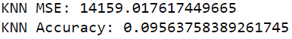
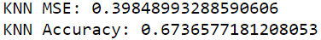
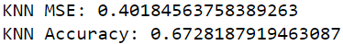
KNN
Df1 – Has the Highest Accuracy
Df2 – Cheapest Price Categorized
Df3 – Price and Duration Categorized

Slide 27
Model Prediction Conclusions: Random Forest
The Random Forest gave the highest accuracy of 74% on the first data frame (Df1)
Feature Importance:
Winter is the cheapest season to fly
Carry on bags also seemed to lower the price according to the model. We believe that the carry on bag feature is the cheapest of all four flight features to be chosen from.

Slide 28
Model Prediction Conclusions: Neural Network
The Neural Network model gave the best accuracy for the second and third data frames:
Df2 = 69%
Df3 = 70%
The Neural Network was unable to handle the cheapest price and flight duration prior to being categorized into 5 groups each

Slide 29
Model Improvements

Slide 30
Updates Made
Updating the Crawling code by adding an option of ‘no flight feature selected’, re-ran the program, and gathered another 6000+ flights to my data
Previous data frame had roughly 6000+ rows
New data frame has about 12,000+ rows
We believe that adding this feature will increase the prediction accuracy of the models

Slide 31
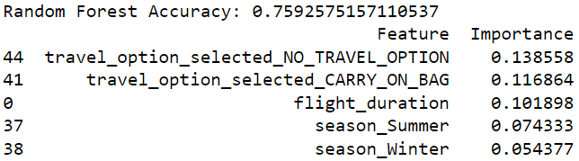
Comparing Random Forest Results
NEW
VS.
OLD

Slide 32
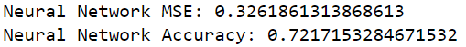
Comparing Neural Network Results
NEW Df2
VS.
OLD Df2
NEW Df2
VS.
OLD Df2

Slide 33
Conclusion

Slide 34
Conclusions
The project’s goal was to predict the cheapest flight prices based on the different attributes chosen
We approached this problem by using multiple machine learning models to try and optimize the prediction accuracy
We saw that with slight improvements to the algorithm, the model’s prediction accuracy increases, changing the number of trees in the random forest, and so on…

